Slide 1
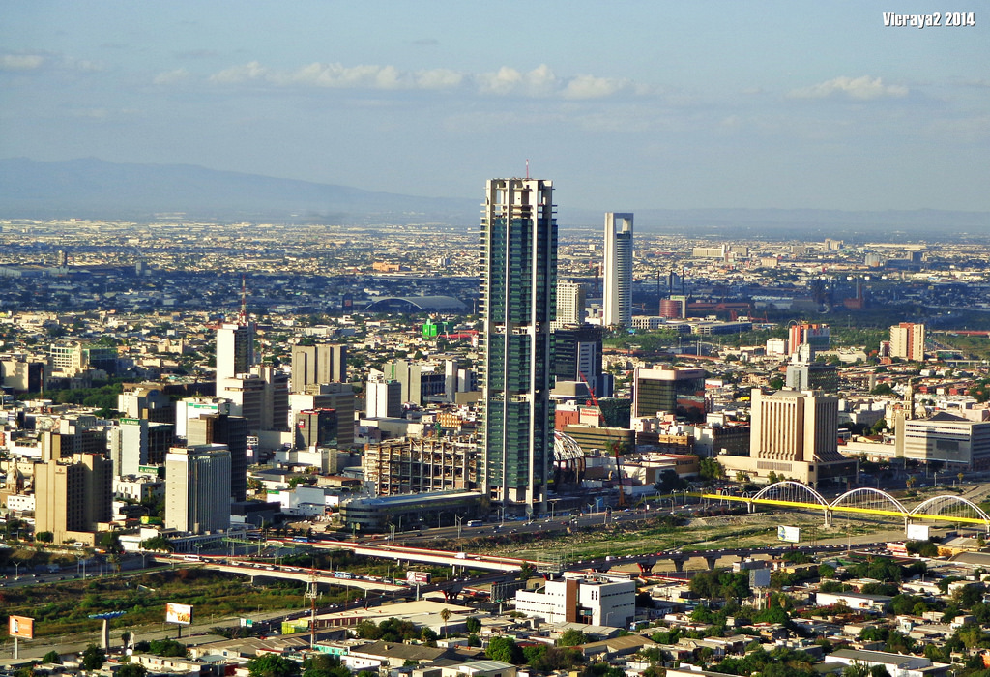
STRATEGIC LOCATION
‘CITY OF MONTERREY, MEXICO’

Slide 2
The Focus of part 1:
The strategic position
How to analyse an organisation’s position in the external environment.
How to analyse the determinants of strategic capability – resources, competences and the linkages between them.
How to understand an organisation’s purposes, taking into account corporate governance, stakeholder expectations and business ethics.
How to address the role of history and culture in determining an organisation’s position.

Slide 3
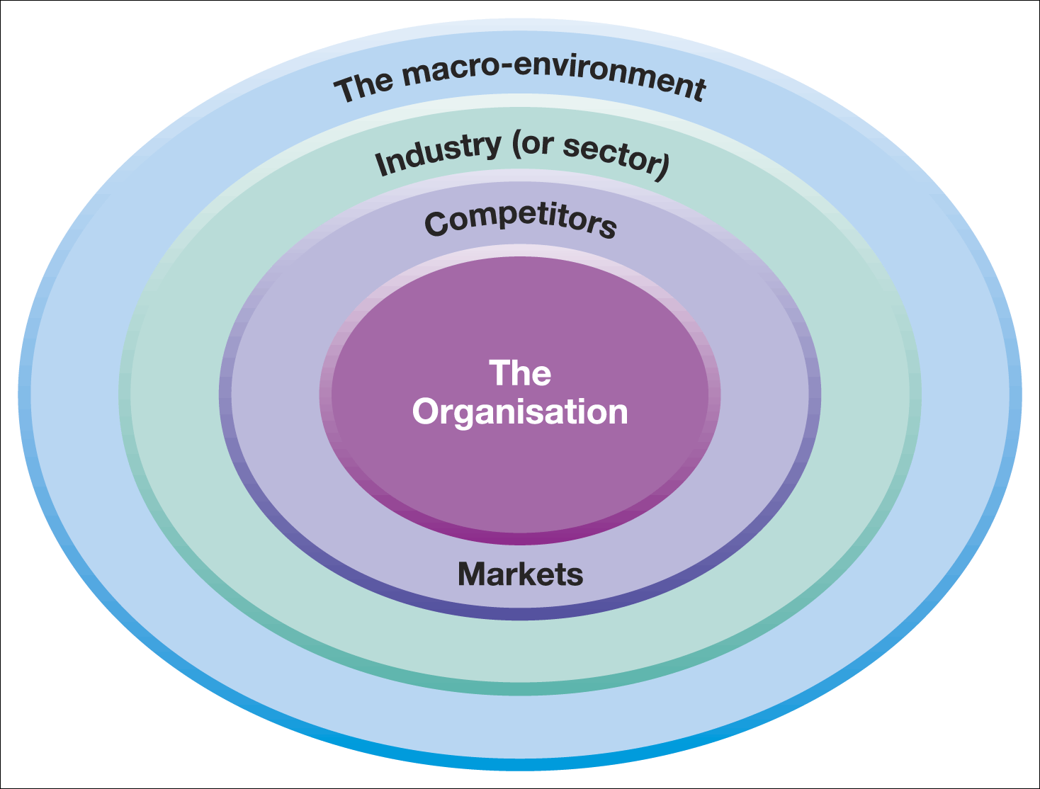
Layers of the business environment
Figure 2.1 Layers of the business environment

Slide 4
ANALYZING EACH LAYER
1. MACRO-ENVIRONMENT
- PESTEL
2. INDUSTRY
  - PORTER 5 FORCES
3. COMPETITION
  - COMPETITOR ANALYSIS
4. ORGANIZATION
  - KEY SEGMENT ANALYSIS

Slide 5
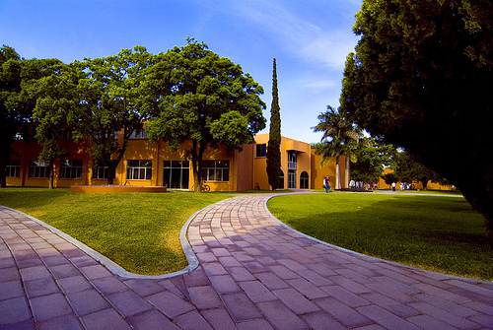
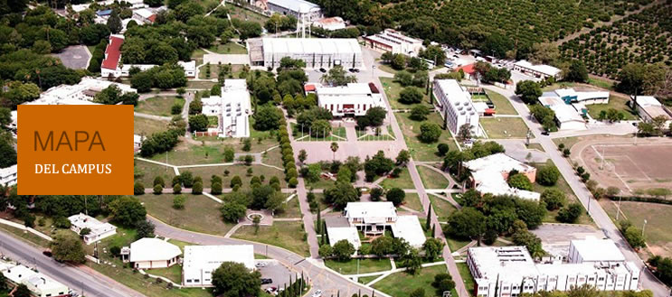
1. MACRO ENVIRONMENT

Slide 6

1.1 The PESTEL framework (i)
The PESTEL framework categorises environmental influences into six main types:
political, economic,
socio-cultural technological,
environmental legal / regulatory
Thus PESTEL provides a comprehensive list of influences on the possible success or failure of particular strategies.

Slide 7
The PESTEL framework (ii)
Political Factors: For example, Government policies, taxation changes, foreign trade regulations, political risk in foreign markets, changes in trade blocks (EU).
Economic Factors: For example, business cycles, interest rates, personal disposable income, exchange rates, unemployment rates, GDP trends.
Socio-cultural Factors: For example, population changes, income distribution, lifestyle changes, consumerism, changes in culture and fashion.

Slide 8
The PESTEL framework (iii)
Technological Factors: For example, new discoveries and technology developments, ICT innovations, rates of obsolescence, increased spending on R&D.
Environmental (‘Green’) Factors: For example, environmental protection regulations, energy consumption, global warming, waste disposal and re-cycling.
Legal Factors: For example, competition laws, health and safety laws, employment laws, licensing laws, IPR laws.

Slide 9
Using the PESTEL framework
Apply selectively –identify specific factors which impact on the industry, market and organisation in question.
Identify factors which are important currently but also consider which will become more important in the next few years.
Use data to support the points and analyse trends using up to date information
Identify opportunities and threats – the main point of the exercise!

Slide 10
1.2 Scenarios
Scenarios are detailed and plausible views of how the environment of an organisation might develop in the future based on key drivers of change about which there is a high level of uncertainty.
Build on PESTEL analysis .
Do not offer a single forecast of how the environment will change.
An organisation should develop a few alternative scenarios (2–4) to analyse future strategic options.

Slide 11
Carrying out scenario analysis
Identify the most relevant scope of the study – the relevant product/market and time span.
Identify key drivers of change – PESTEL factors that have the most impact in the future but have uncertain outcomes.
For each key driver select opposing outcomes where each leads to very different consequences.

Slide 12
Carrying out scenario analysis
Develop scenario ‘stories’ - That is, coherent and plausible descriptions of the environment that result from opposing outcomes
Identify the impact of each scenario on the organisation and evaluate future strategies in the light of the anticipated scenarios.
Scenario analysis is used in industries with long planning horizons for example, the oil industry or airlines.

Slide 13
LAYER #2 - INDUSTRY
Figure 2.1 Layers of the business environment

Slide 14
2. Industries, markets and sectors
An industry is a group of firms producing products and services that are essentially the same. For example, automobile industry and airline industry.
A market is a group of customers for specific products or services that are essentially the same (e.g. the market for luxury cars in Germany).
A sector is a broad industry group (or a group of markets) especially in the public sector (e.g. the health sector)

Slide 15
Types of industry (1)
Monopolistic industries - an industry with one firm and therefore no competitive rivalry. A firm has ‘monopoly power’ if it has a dominant position in the market. For example, BT in the UK fixed line telephone market.
Oligopolistic industries - an industry dominated by a few firms with limited rivalry and in which firms have power over buyers and suppliers.
Perfectly competitive industries - where barriers to entry are low, there are many equal rivals each with very similar products, and information about competitors is freely available. Few (if any) markets are ‘perfect’ but may have features of highly competitive markets, for example, mini-cabs in London.

Slide 16
Types of industry (2)
Hypercompetitive industries - where the frequency, boldness and aggression of competitor interactions accelerate to create a condition of constant disequilibrium and change.
Hypercompetition often breaks out in otherwise oligopolistic industries (e.g. mobile phones).

Slide 17
Industry Attractiveness (3)
‘Porter’s five forces framework’
Porter’s five forces framework helps identify the attractiveness of an industry in terms of five competitive forces:
the threat of entry,
the threat of substitutes,
the bargaining power of buyers,
the bargaining power of suppliers and
the extent of rivalry between competitors.
The five forces constitute an industry’s ‘structure’.

Slide 18
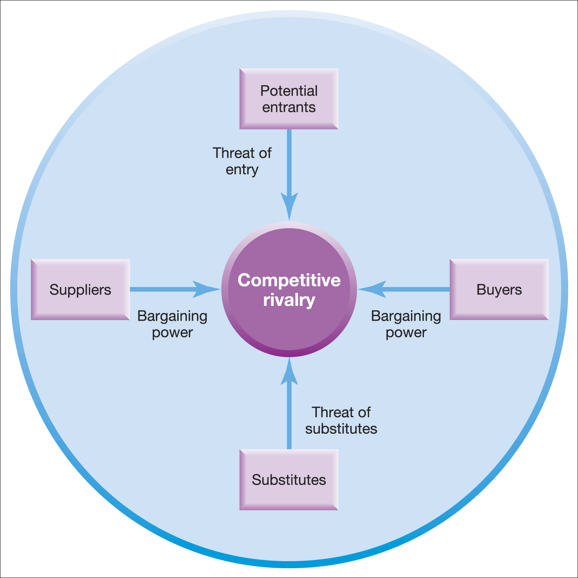
The five forces framework
Figure 2.2 The five forces framework
Source: Adapted with the permission of The Free Press, a Division of Simon & Schuster Adult Publishing Group, from Competitive Strategy: Techniques for Analyzing Industries and Competitors by Michael E. Porter. Copyright © 1980, 1998 by The Free Press. All rights reserved

Slide 19
The five forces framework (1)
The Threat of Entry & Barriers to Entry
The threat of entry is low when the barriers to entry are high and vice versa.
The main barriers to entry are:
  Economies of scale/high fixed costs
  Experience and learning
  Access to supply and distribution channels
  Differentiation and market penetration costs
  Government restrictions (e.g. licensing)
Entrants must also consider the expected retaliation from organisations already in the market

Slide 20
The five forces framework (2)
Threat of Substitutes
Substitutes are products or services that offer a similar benefit to an industry’s products or services, but by a different process.
Customers will switch to alternatives (and thus the threat increases) if:
The price/performance ratio of the substitute is superior (e.g. aluminium maybe more expensive than steel but it is more cost efficient for some car parts)
The substitute benefits from an innovation that improves customer satisfaction (e.g. high speed trains can be quicker than airlines from city centre to city centre)

Slide 21
The five forces framework (3)
The bargaining power of buyers
Buyers are the organisation’s immediate customers, not necessarily the ultimate consumers.
If buyers are powerful, then they can demand cheap prices or product / service improvements to reduce profits .
Buyer power is likely to be high when:
  Buyers are concentrated
  Buyers have low switching costs
  Buyers can supply their own inputs (backward vertical integration)

Slide 22
The five forces framework (4)
The bargaining power of suppliers
Suppliers are those who supply what organisations need to produce the product or service. Powerful suppliers can eat into an organisation’s profits.
Supplier power is likely to be high when:
  The suppliers are concentrated (few of them).
  Suppliers provide a specialist or rare input.
  Switching costs are high (it is disruptive or expensive to change suppliers).
  Suppliers can integrate forwards (e.g. low cost airlines have cut out the use of travel agents).

Slide 23
The five forces framework (5)
Rivalry between competitors
Competitive rivals are organisations with similar products and services aimed at the same customer group and are direct competitors in the same industry/market (they are distinct from substitutes).
The degree of rivalry is increased when :
  Competitors are of roughly equal size
  Competitors are aggressive in seeking leadership
  The market is mature or declining
  There are high fixed costs
  The exit barriers are high
  There is a low level of differentiation

Slide 24
Implications of five forces analysis
Identifies the attractiveness of industries – which industries/markets to enter or leave.
Identifies strategies to influence the impact of the forces, for example, building barriers to entry by becoming more vertically integrated.
The forces may have a different impact on different organisations e.g. large firms can deal with barriers to entry more easily than small firms.

Slide 25
Issues in five forces analysis
Apply at the most appropriate level – not necessarily the whole industry. E.g. The faith-based schools, rather than all schools in the country.
Note the convergence of industries – the growth of health systems rather than mere hospitals.
Note the importance of complementary products and services (e.g. Microsoft windows and McAfee computer security systems are complements). This can almost be considered as a sixth force.

Slide 26
LAYER #3 - COMPETITORS
Figure 2.1 Layers of the business environment

Slide 27
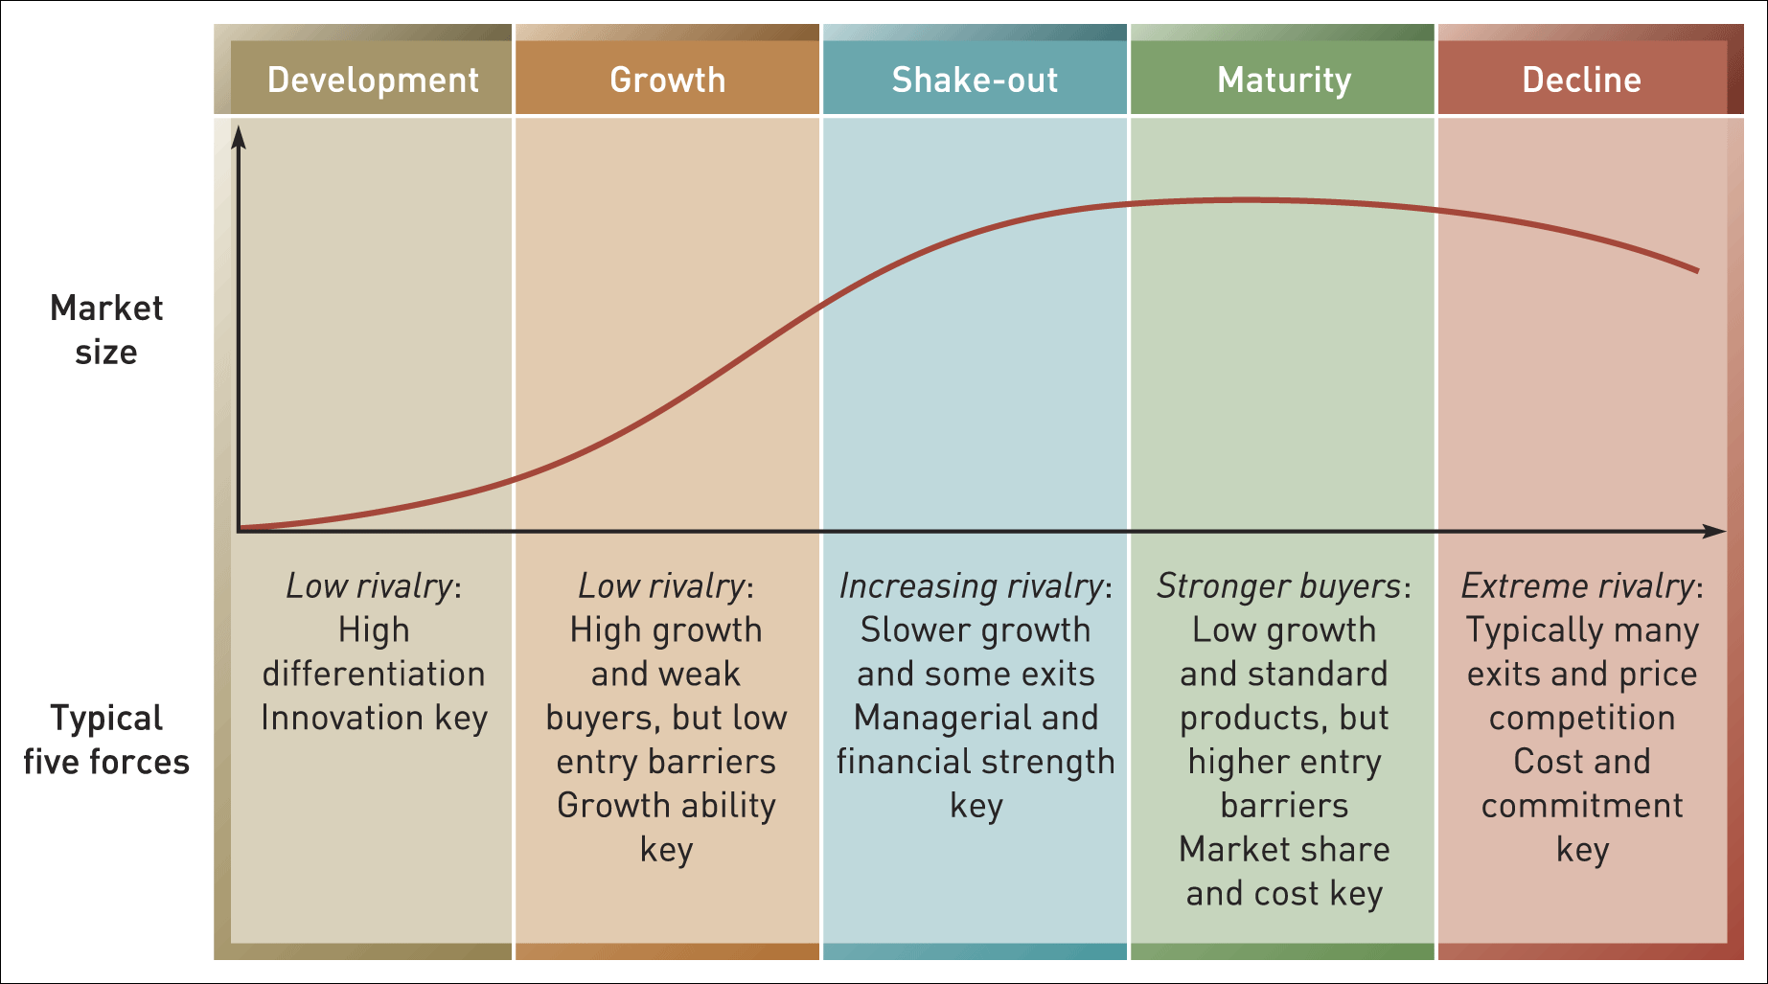
The industry life cycle
Figure 2.4 The industry life cycle

Slide 28

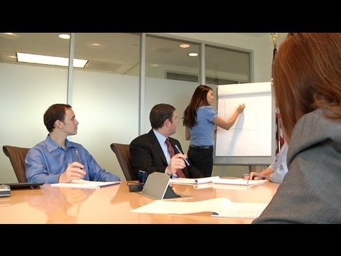
VIDEOS
GROWTH STRATEGY

Slide 29
Strategic Groups
Strategic groups are organisations within an industry or sector with similar strategic characteristics, following similar strategies or competing on similar bases.
These characteristics are different from those in other strategic groups in the same industry or sector.
Eg.1: The International Council of Churches (Religion )
Eg.2: The national Union of Teachers

Slide 30
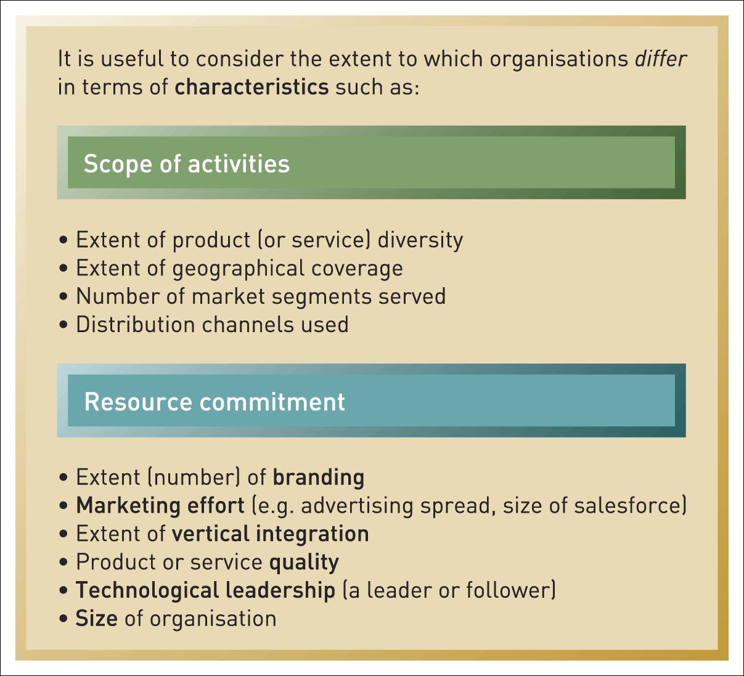
Characteristics for identifying strategic groups
Figure 2.7 Some characteristics for identifying strategic groups

Slide 31
Uses of strategic group analysis
Understanding competition - enables focus on direct competitors within a strategic group, rather than the whole industry. (E.g. Tesco will focus on Sainsburys and Asda)
Analysis of strategic opportunities - helps identify attractive ‘strategic spaces’ within an industry.
Analysis of ‘mobility barriers’ i.e. obstacles to movement from one strategic group to another. These barriers can be overcome to enter more attractive groups. Barriers can be built to defend an attractive position in a strategic group.

Slide 32
LAYER #4 - ORGANIZATION
Figure 2.1 Layers of the business environment

Slide 33
Market segments
A market segment is a group of customers who have similar needs that are different from customer needs in other parts of the market.
Where these customer groups are relatively small, such market segments are called ‘niches’.
Customer needs vary. Focusing on customer needs that are highly distinctive is one means of building a secure segment strategy.
Customer needs vary for a variety of reasons -these factors can be used to identify distinct market segments.
Not all segments are attractive or viable market opportunities – evaluation is essential.

Slide 34
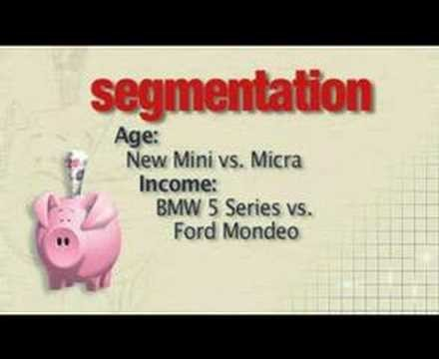
VIDEOS
SEGMENTATION STRATEGY

Slide 35
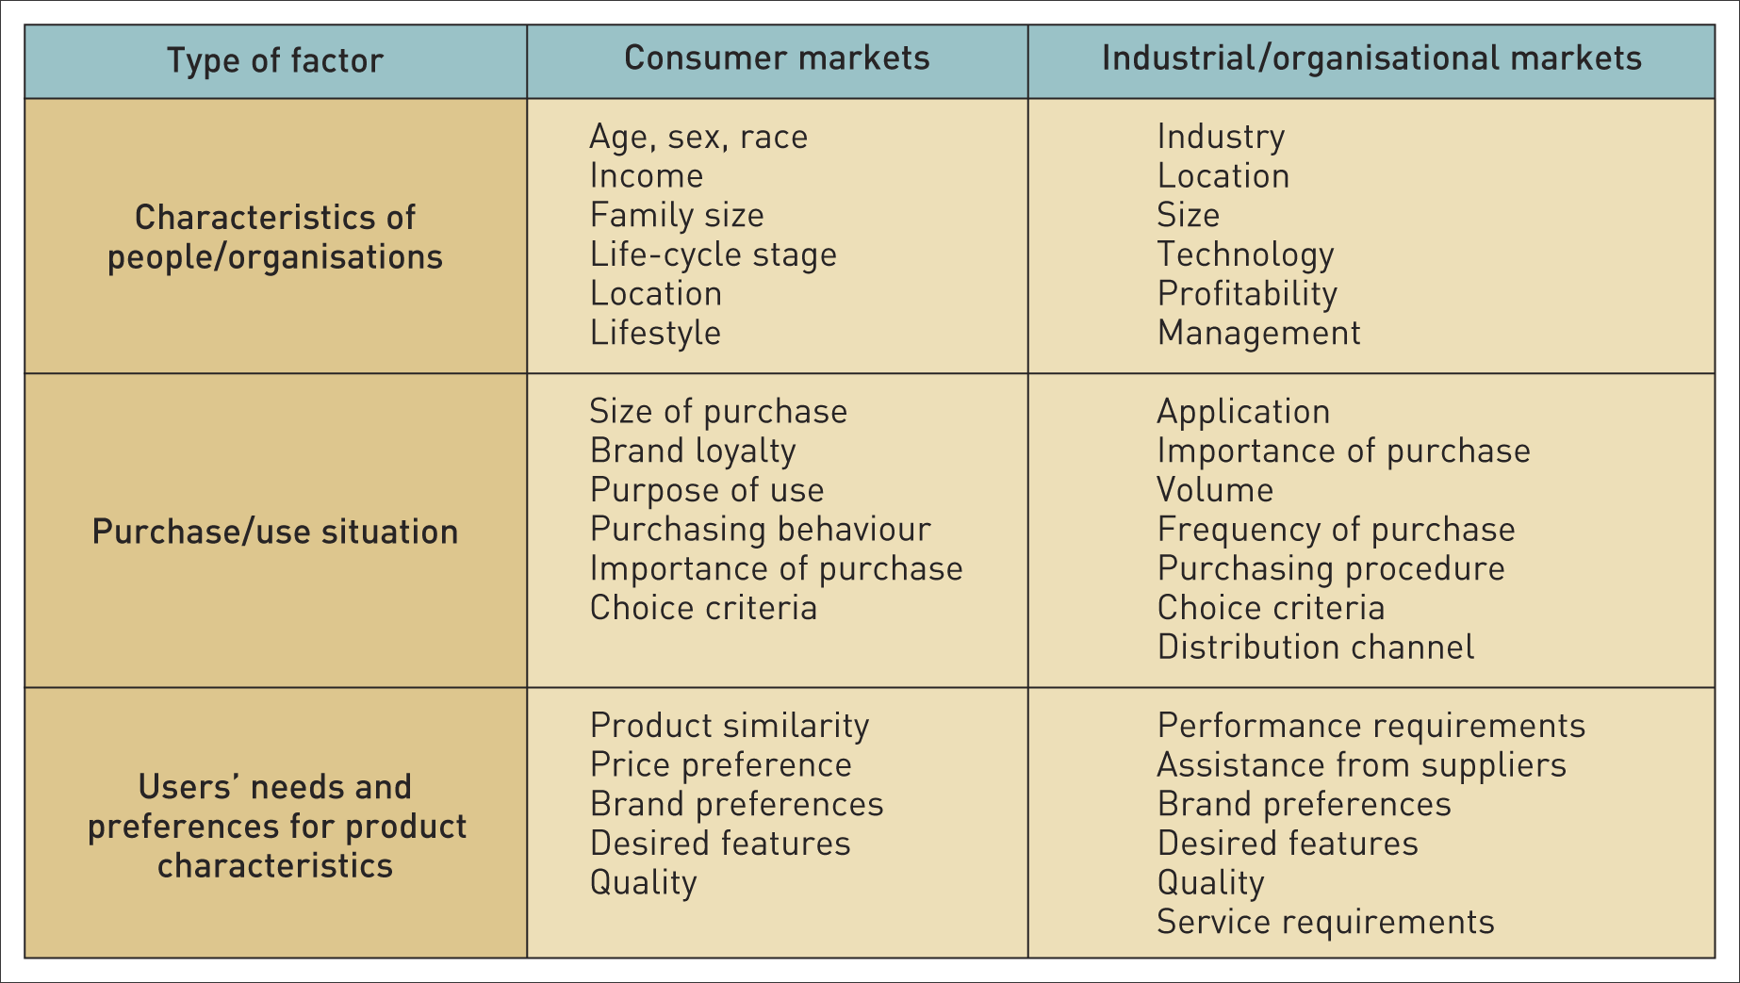
Bases of market segmentation
Table 2.1 Some bases of market segmentation

Slide 36
Who are the strategic customers that we should target?
A strategic customer is the person(s) at whom the strategy is primarily addressed because they have the most influence over which goods or services are purchased.
Examples:
For a food manufacturer it is the multiple retailers (e.g. Tesco) that are the strategic customers not the ultimate consumer.
For a pharmaceutical manufacturer it is the health authorities and hospitals not the final patient.

Slide 37
Critical success factors (CSFs)
Critical success factors are those factors that are either particularly valued by customers or which provide a significant advantage in terms of cost.
E.g.: in low cost airlines the CSFs will be punctuality and value for money whereas in full service airlines it is all about quality of service

Slide 38
Ex. 1
Critical success factors (CSFs)
List the top three (3) Critical Success Factors of your organization or Company.

Slide 39
Blue ocean thinking
‘Blue oceans’ are new market spaces where competition is minimised.
‘Red Oceans’ are where industries are already well defined and rivalry is intense.
Blue Ocean thinking encourages entrepreneurs and managers to be different by finding or creating market spaces that are not currently being served.

Slide 40
Ex. 2
Blue ocean thinking
WHAT IS THE DIFFERENCE BETWEEN RED AND BLUE OCEAN STRATEGY
STATE ONE (1) BLUE OCEAN AREA FOR ENHANCING YOUR COMPANY STRATEGY

Slide 41

VIDEOS
BLUE OCEAN STRATEGY

Slide 42
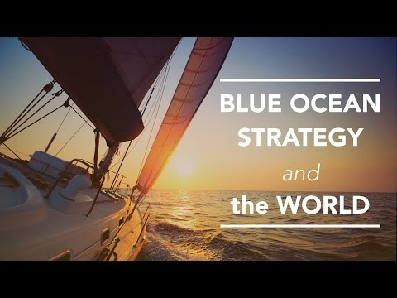
VIDEOS
BLUE OCEAN STRATEGY

Slide 43
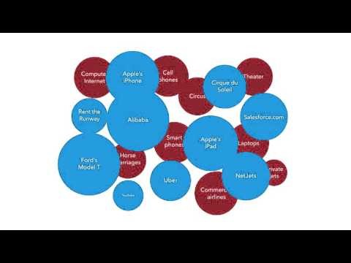
VIDEOS
BLUE OCEAN STRATEGY EXAMPLE 1

Slide 44

VIDEOS
BLUE OCEAN STRATEGY EXAMPLE 2

Slide 45
STRATEGIC CAPABLITIES

Slide 46
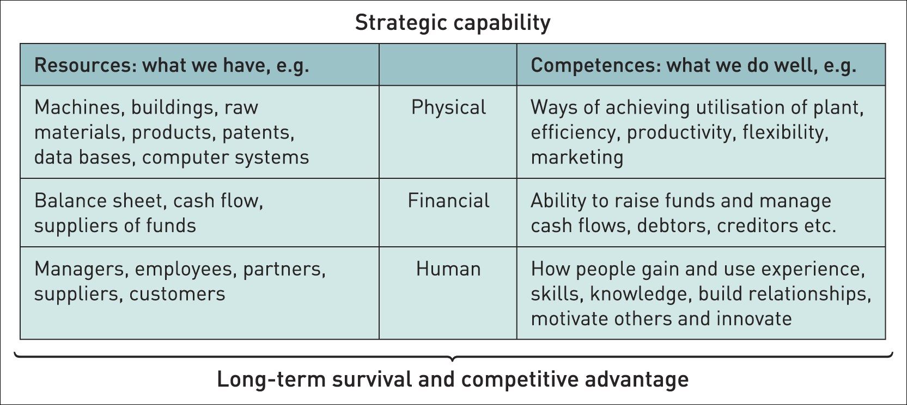
Components of strategic capabilities

Slide 47
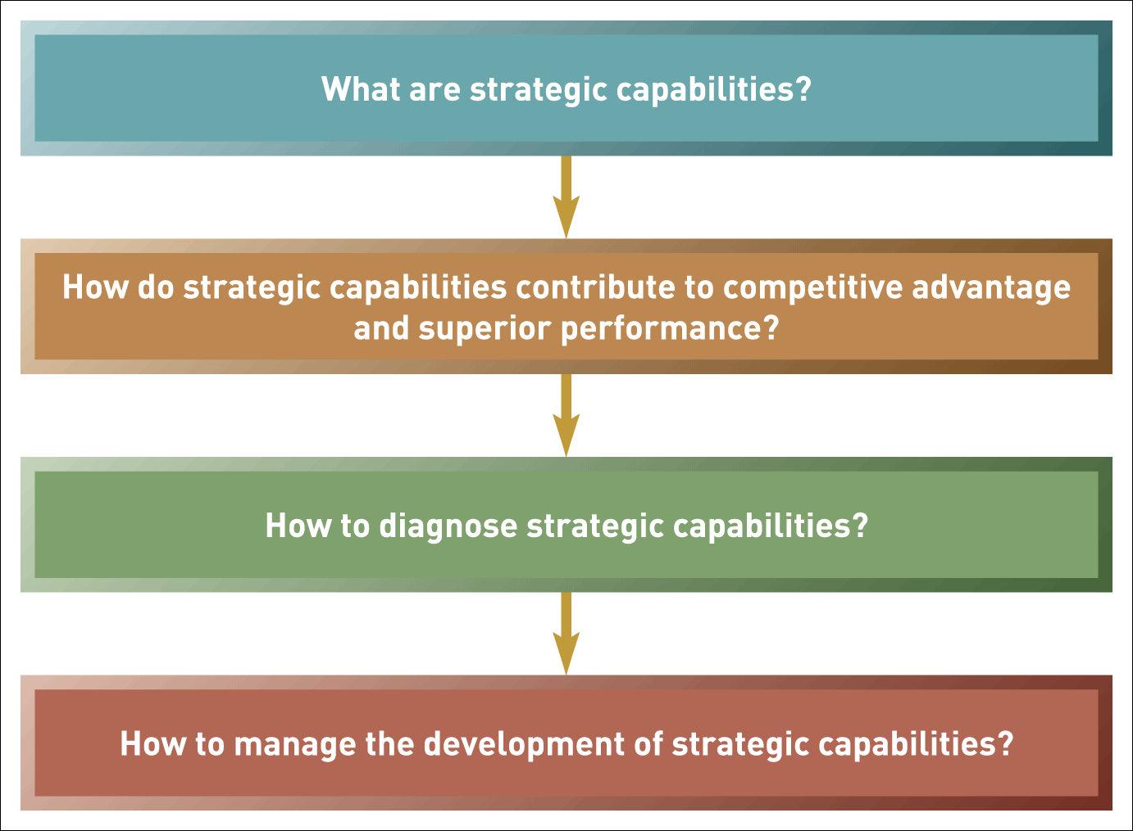
Strategic capabilities: the key issues

Slide 48
Resource-based strategy
The resource-based view (RBV) of strategy asserts that the competitive advantage and superior performance of an organisation is explained by the distinctiveness of its capabilities.

Slide 49
Dynamic capabilities
Dynamic capability is the ability of an organisation to renew and recreate its strategic capabilities to meet the needs of changing environments.

Slide 50
Threshold and distinctive capabilities (1)
Threshold capabilities are those needed for an organisation to meet the necessary requirements to compete in a given market and achieve parity with competitors in that market – ‘qualifiers’.
Distinctive capabilities are those that critically underpin competitive advantage and that others cannot imitate or obtain – ‘winners’.

Slide 51
Ex. 3
Components of Strategic Capabilities
Using the above frameworks, what are the Components of Strategic Capabilities of your own Company or Organization?

Slide 52
Core competences
Core competences are the linked set of skills, activities and resources that, together:
deliver customer value
differentiate a business from its competitors
potentially, can be extended and developed as markets change or new opportunities arise.

Slide 53
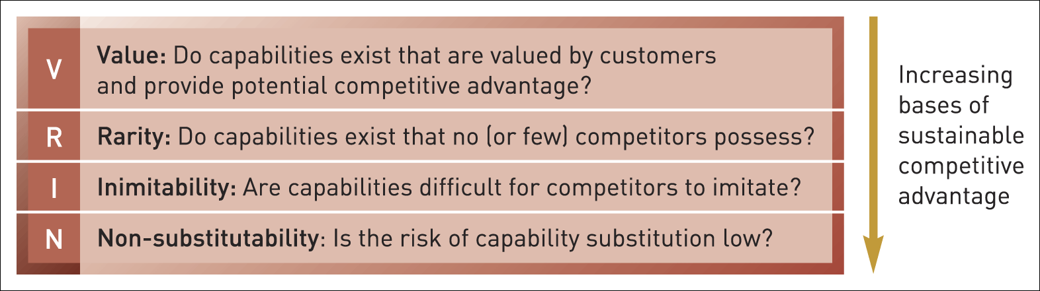
Ex. 4
Which is the Key Concept for your Organizational Competence and competitiveness?
Answer honestly each question below...
Figure 3.3 VRIN

Slide 54
Key Concept
I – Inimitability
Inimitable capabilities are those that competitors find difficult to imitate or obtain.
Competitive advantage can be built on unique resources (a key individual or IT system) but these may not be sustainable (key people leave or others acquire the same systems).
Sustainable advantage is more often found in competences (the way resources are managed, developed and deployed) and the way competences are linked together and integrated.

Slide 55
Benchmarking
Benchmarking is a means of understanding how an organisation compares with others – typically competitors.
Two approaches to benchmarking:
Industry/sector benchmarking - comparing performance against others in the same industry/sector against a set of performance indicators.
Best-in-class benchmarking - comparing your performance or capabilities against ‘best-in-class’ performance

Slide 56
Ex.5
Benchmarking
Benchmarking is a means of understanding how an organisation compares with others – typically competitors.
---------------------------------------------------------
List a Benchmark standard for one (1) aspect of your company’s work
How does your company measure up to that benchmark?

Slide 57
Environmental Scanning
SWOT ANALYSIS

Slide 58
Ex.6
Give one (1) example of each for your Company / Organization
SWOT summarises the strengths, weaknesses, opportunities and threats likely to impact on strategy development.
INTERNAL STRENGTHS WEAKNESSES
ANALYSIS
EXTERNAL OPPORTUNITIES THREATS
ANALYSIS

Slide 59
Uses of SWOT analysis
Key environmental impacts are identified
Major strengths and weaknesses are identified.
Scoring (e.g. + 5 to - 5) can be used to assess the interrelationship between environmental impacts and the strengths and weaknesses.
SWOT can be used to examine strengths, weaknesses, opportunities and threats in relation to competitors.
SWOT can be used to generate strategic options– using a TOWS matrix.

Slide 60
Dangers in a SWOT analysis
Long lists with no attempt at prioritisation.
Over generalisation – sweeping statements often based on biased and unsupported opinions.
SWOT is used as a substitute for analysis – it should result from detailed analysis using the frameworks in Chapters 2 and 3.
SWOT is not used to guide strategy – it is seen as an end in itself.

Slide 61
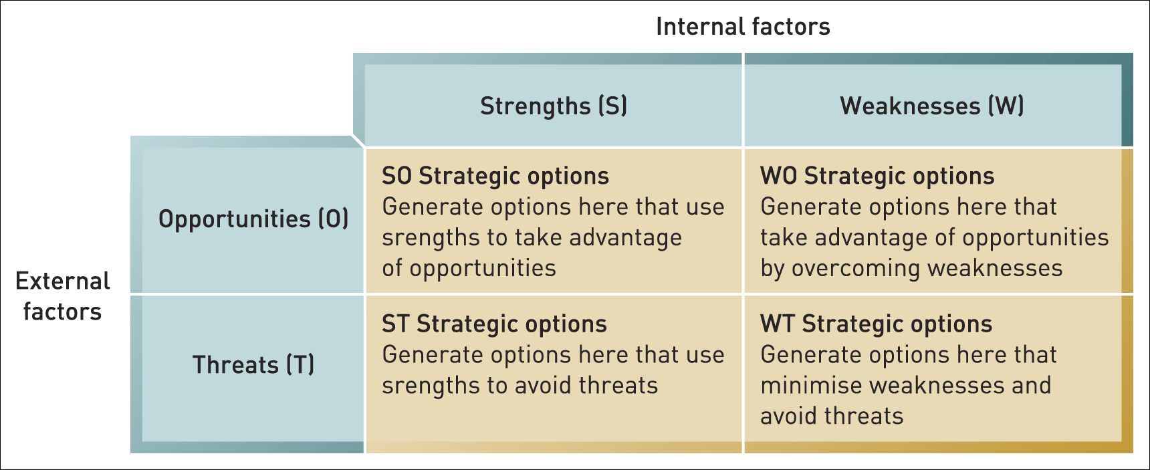
The TOWS matrix
Figure 3.6 The TOWS matrix

Slide 62
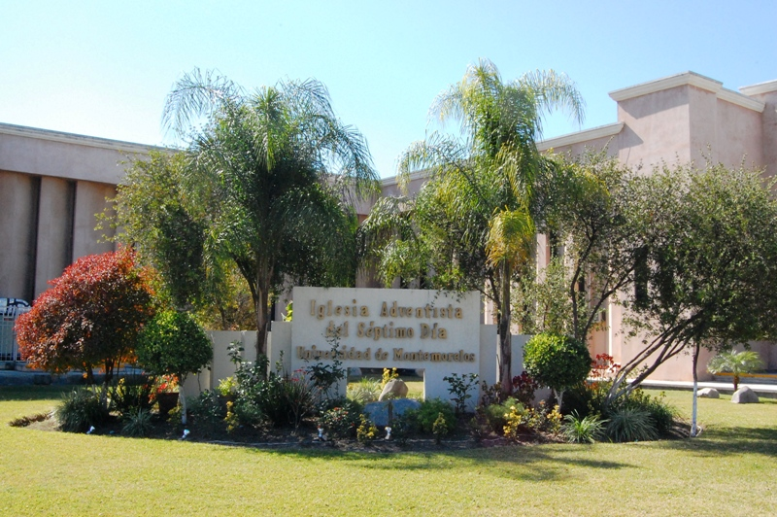
STRATEGIC PURPOSE

Slide 63
Ex. 7
Corporate Social Responsibility
(CSR)
Suggest one main way or example that your company may use to improve its CSR

Slide 64
Corporate social responsibility
Corporate social responsibility (CSR) is the commitment by organisations to ‘behave ethically and contribute to economic development while improving the quality of life of the workforce and their families as well as the local community and society at large’.¹
¹ World Business Council for Sustainable Development.

Slide 65
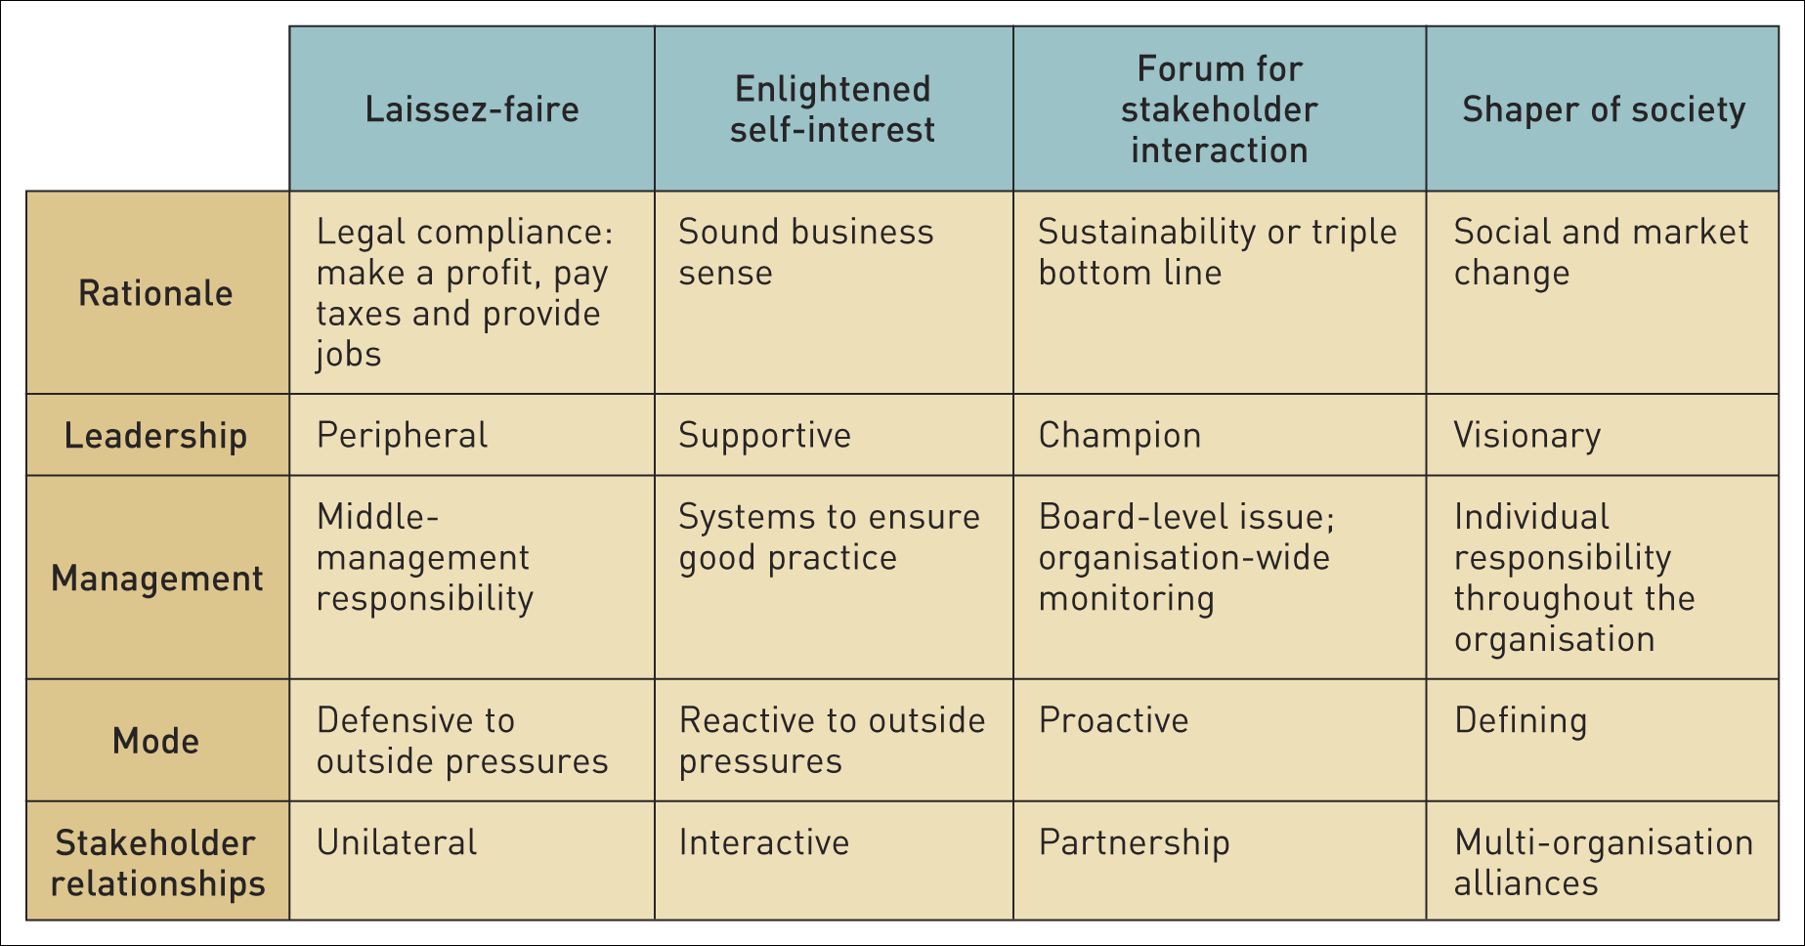
Corporate social responsibility stances
Table 4.2 Corporate social responsibility stances

Slide 66
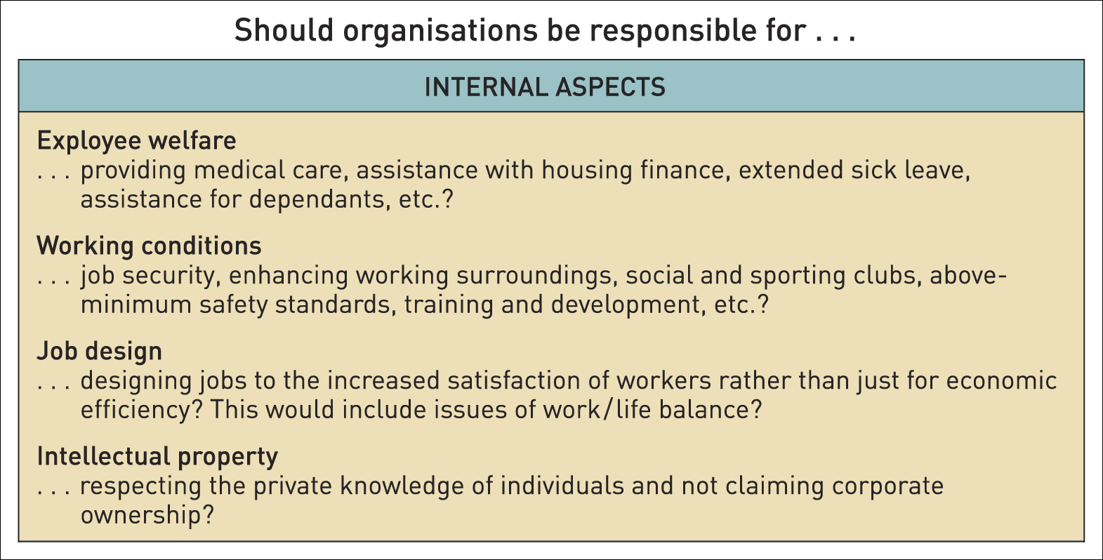
Questions of corporate social responsibility – internal aspects (1)
Table 4.3 Some questions of corporate social responsibility

Slide 67
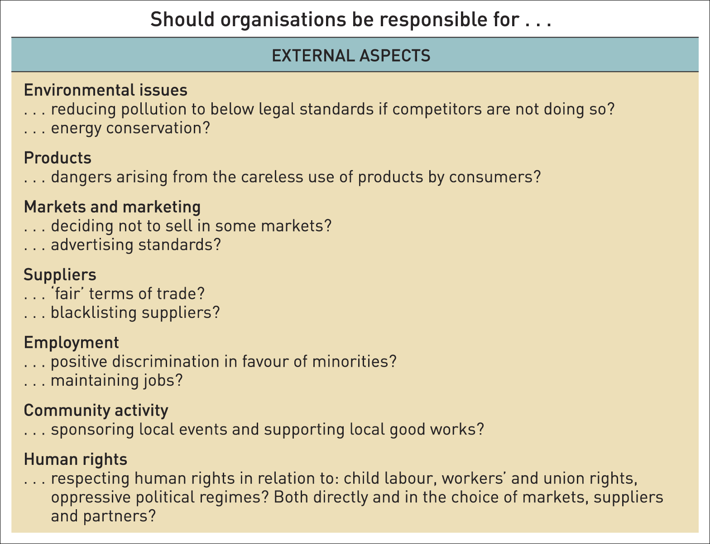
Questions of corporate social responsibility – external aspects (2)
Table 4.3 Some questions of corporate social responsibility (Continued)

Slide 68

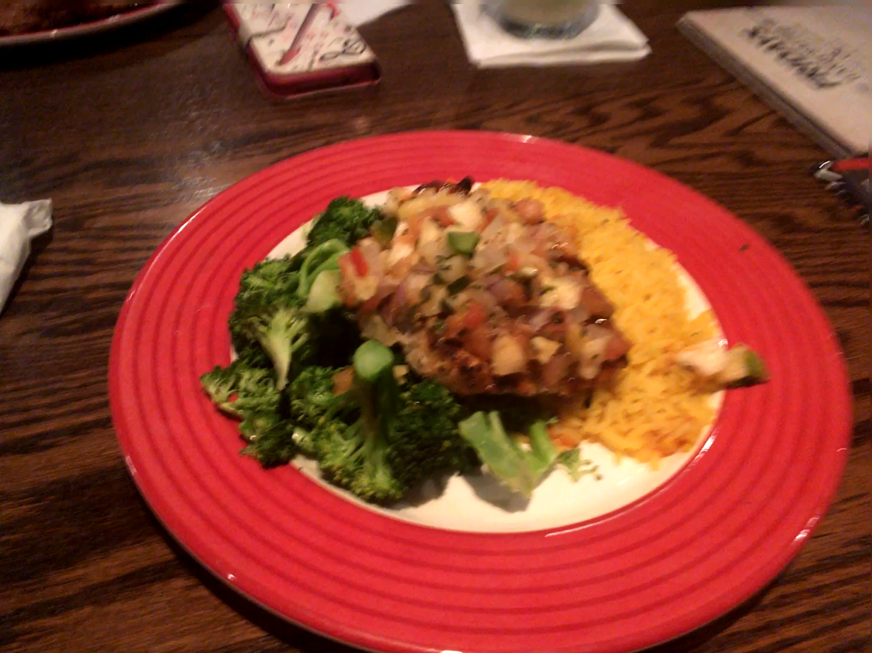
STRATEGY & CULTURE
---- Behind the Mask ---

Slide 69
Ex. 8
The CULTURAL WEB
Which of the elements of your Organization’s Cultural Web most greatly influenced or determined your:
  Organizational Culture
  Organizational Strategy

Slide 70
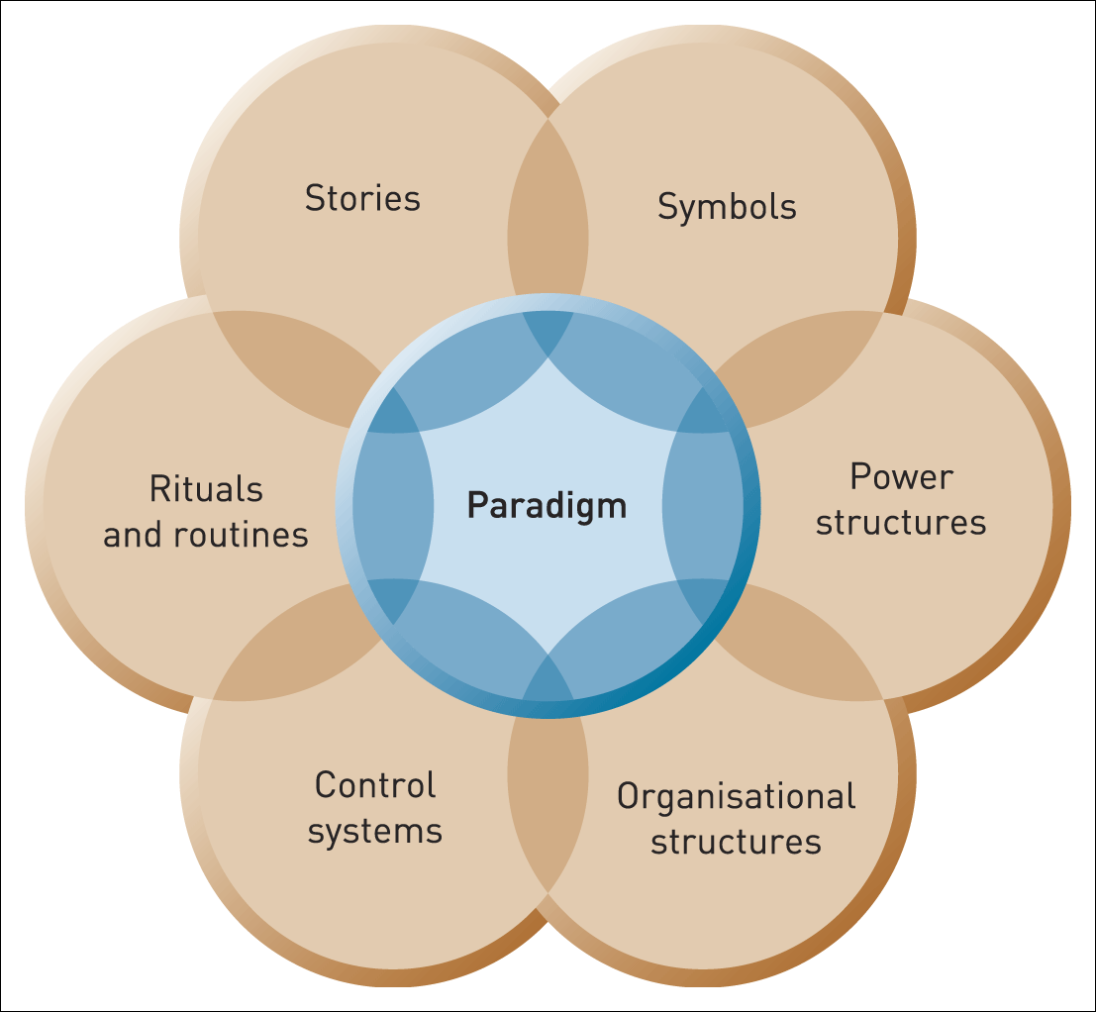
The cultural web of an organisation

Slide 71
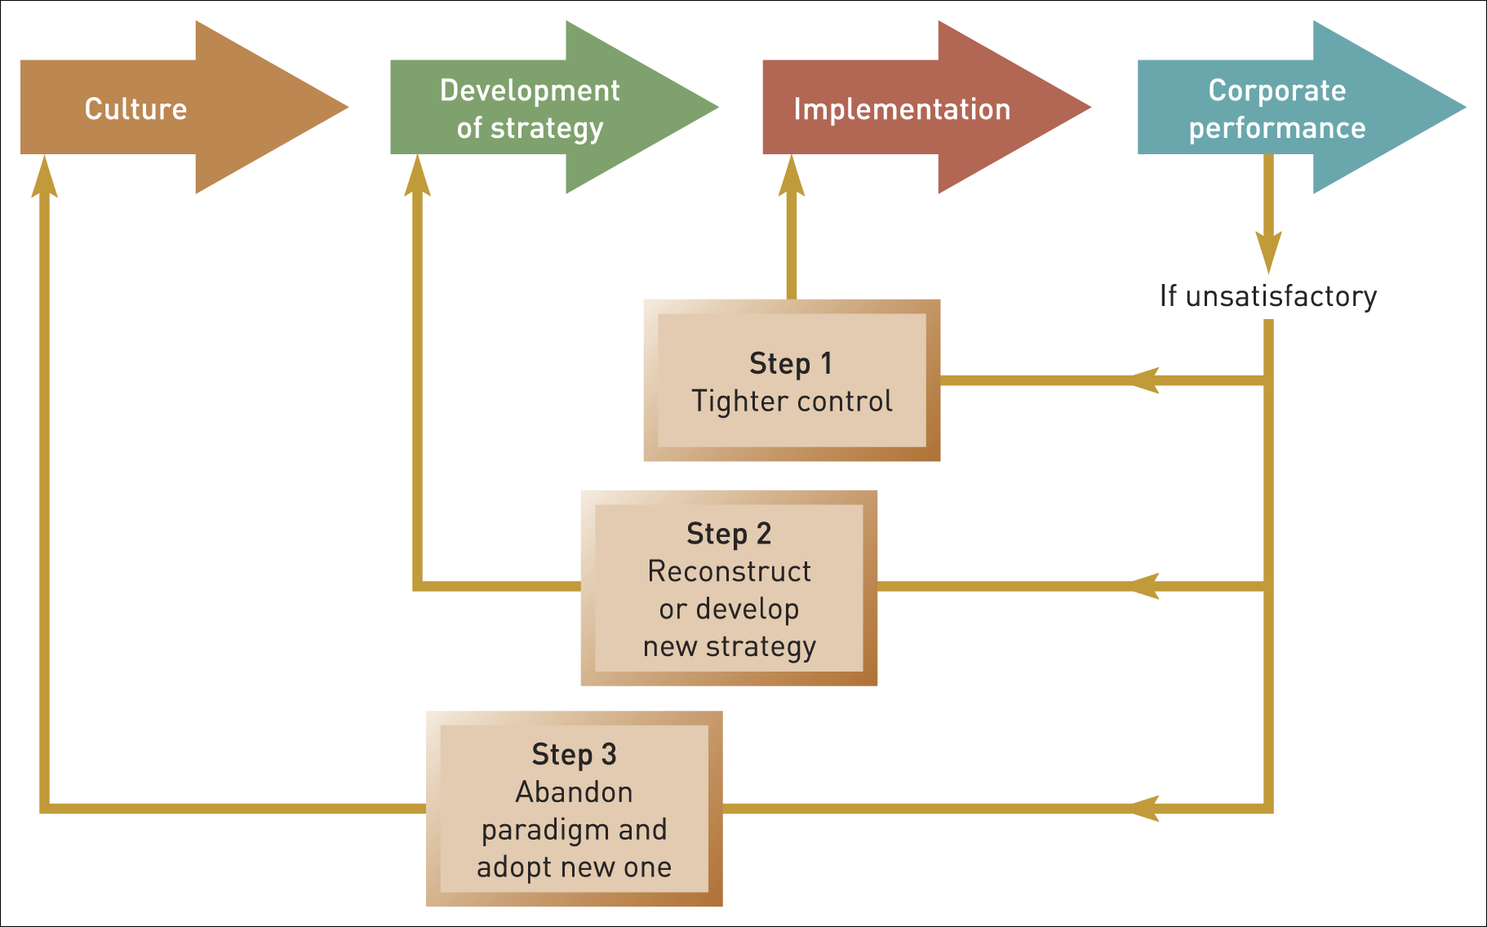
Culture’s influence on strategy development
Figure 5.6 Culture’s influence on strategy development
Source: Adapted from P. Gringer and J.-C. Spender, Turnaround: Managerial Recipes for Strategic Success, Associated Business Press, 1979, p. 203

Slide 72
The paradigm
The paradigm is the set of assumptions held in common and taken for granted in an organisation.
The paradigm:
is built on collective experience
informs what people in the organisation do
influences how organisations respond to change.

Slide 73
The cultural web
The cultural web shows the behavioural, physical and symbolic manifestations of a culture that inform and are informed by the taken-for-granted assumptions, or paradigm, of an organisation

Slide 74
The cultural web of an organisation (1)
Figure 5.7 The cultural web of an organisation

Slide 75
The cultural web of an organisation (2) – stories
--------------------------------------------
What core beliefs do the stories reflect?
What stories are commonly told e.g. to newcomers
How do these stories reflect core assumptions and beliefs?
Stories
Paradigm
Notes:
The style/artwork can be tidied up here.

Slide 76
The cultural web of an organisation (3) – symbols
---------------------------------------------
Symbols are objects, events, acts or people that convey, maintain or create meaning over and above their functional purpose.
What objects, people or events do people in the organisation particularly identify with?
What are these related to in the
history of the organisation?
Symbols
Paradigm

Slide 77
The cultural web of an organisation (4) – power structures
------------------------------------------------------
Where does power reside?
Who makes things happen?
Paradigm
Power
structures

Slide 78
The cultural web of an organisation
(5) – organisation structure
------------------------------------------
How formal/informal are the structures?
Do structures encourage collaboration or competition?
What types of power structure do they support?
Paradigm
Organisation
Structure

Slide 79
The cultural web of an organisation
(6) – control systems
-----------------------------------
What is most closely monitored/controlled?
Is emphasis on reward or punishment?
Are controls rooted in history or current strategies?
Are there many/few controls?
Paradigm
Control
systems

Slide 80
The cultural web of an organisation
(7) – routines and rituals
----------------------------
Which routines are emphasised?
Which are embedded in history?
What behaviour do routines encourage?
What are the key rituals?
What assumptions and core beliefs do they reflect?
What do training programmes
emphasise?
How easy are routines/rituals
to change?
Rituals/
routines
Paradigm

Slide 81
Summary (1)
The history and culture of an organisation may contribute to its strategic capabilities, but may also give rise to strategic drift as its strategy develops incrementally on the basis of such influences and fails to keep pace with a changing environment.
Historical, path-dependent processes play a significant part in the success or failure of an organisation and need to be understood by managers. There are historical analyses that can be conducted to help uncover these influences.

Slide 82
Summary (2)
Cultural and institutional influences both inform and constrain the strategic development of organisations.
Organisational culture is the basic assumptions and beliefs that are shared by members of an organisation, that operate unconsciously and define in a basic taken-for-granted fashion an organisation’s view of itself and its environment.
An understanding of the culture of an organisation and its relationship to organisational strategy can be gained by using the cultural web.

