Slide 1
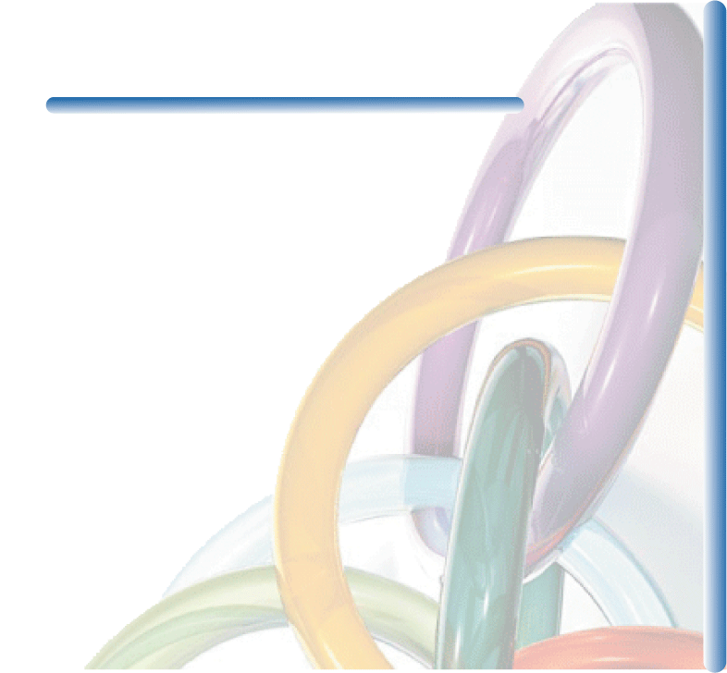
UNIVERSIDAD DE MONTEMORELOS
ECONOMICS PRESENTATION
PHD PRE-REQUISITE CERTIFICATE PROGRAM
-----------------------------------------------------
Presented by: Dr. Stephen Pilgrim, Ph. D (Econ)
Materials: Prentice Hall Publishers

Slide 2
LECTURE 1 – PART 1 - OUTLINE
1.1 The Themes of Microeconomics
1.2 What Is a Market?
1.3 Real versus Nominal Prices
1.4 Why Study Microeconomics?

Slide 3
Preliminaries
● ___________economics Branch of economics that deals with the behavior of individual economic units—consumers, firms, workers, and investors—as well as the markets that these units comprise.
● ______________economics Branch of economics that deals with aggregate economic variables, such as the level and growth rate of national output, interest rates, unemployment, and inflation.

Slide 4
THE THEMES OF MICROECONOMICS
1.1
Trade-Offs
Consumers
Consumers have limited ___________, which can be spent on a wide variety of goods and services, or saved for the future.
Workers
Workers also face _____________ and ___________________. First, people must decide whether and when to enter the workforce. Second, workers face trade-offs in their choice of
employment. Finally, workers must sometimes decide how many hours per week they wish to work, thereby trading off
labor for leisure.
Firms
Firms also face limits in terms of the kinds of____________that they can produce, and the ____________ available to produce them.

Slide 5
THE THEMES OF MICROECONOMICS
1.1
Prices and Markets
Microeconomics describes how prices are determined.
In a centrally planned economy, prices are set by the government.
In a market economy, prices are determined by the interactions of consumers, workers, and firms.
These interactions occur in markets—collections of buyers and sellers that together determine the price of a good.

Slide 6
THE THEMES OF MICROECONOMICS
1.1
Theories and Models
In economics, explanation and prediction are based on ________
Theories are developed to explain observed phenomena in terms of a set of basic rules and assumptions.
A __________is a mathematical representation, based on economic theory, of a firm, a market, or some other entity.
Positive versus Normative Analysis
● ___________ analysis Analysis describing relationships of cause and effect.
● ___________ analysis Analysis examining questions of what ought to be.

Slide 7
WHAT IS A MARKET?
1.2
● ___________ Collection of buyers and sellers that, through their actual or potential interactions, determine the price of a product or set of products.
● market definition Determination of the buyers, sellers, and range of products that should be included in a particular market.
● ___________ Practice of buying at a low price at one location and selling at a higher price in another.

Slide 8
WHAT IS A MARKET?
1.2
Competitive versus Noncompetitive Markets
● ___________________________ Market with many buyers and sellers, so that no single buyer or seller has a significant impact on price.
Market Price
● ________________ Price prevailing in a competitive market.

Slide 9
WHAT IS A MARKET?
1.2
Market Definition—The Extent of a Market
● extent of a market Boundaries of a market, both geographical and in terms of range of products produced and sold within it.
Market definition is important for two reasons:
1. A company must understand who its actual and potential competitors are for the various products that it sells or might sell in the future.
2. Market definition can be important for public policy decisions.

Slide 10

WHAT IS A MARKET?
1.2
Markets are usually defined in terms of therapeutic classes of drugs.
For example, there is a market for antiulcer drugs that is very clearly defined.
Sometimes, however, pharmaceutical market boundaries are more ambiguous, like painkillers.
There are many types of painkillers, and some work better than others for certain types of pain.

Slide 11
WHAT IS A MARKET?
1.2
In 1990, the Archer-Daniels-Midland Company (ADM) acquired the Clinton Corn Processing Company (CCP).
The U.S. Department of Justice (DOJ) challenged the acquisition on the grounds that it would lead to a dominant producer of corn syrup with the power to push prices above competitive levels.
ADM fought the DOJ decision, and the case went to court. The basic issue was whether corn syrup represented a distinct market.
ADM argued that sugar and corn syrup should be considered part of the same market because they are used interchangeably to sweeten a vast array of food products.

Slide 12
REAL VERSUS NOMINAL PRICES
1.3
● nominal price Absolute price of a good, unadjusted for inflation.
● _______________ Price of a good relative to an aggregate measure of prices; price adjusted for inflation.
● Consumer Price Index / ________ Measure of the aggregate price level.
● Producer Price Index Measure of the aggregate price level for intermediate products and wholesale goods.

Slide 13
REAL VERSUS NOMINAL PRICES
1.3
Table 1.1 The Real Price of Eggs and of a College Education
 | 1970 | 1980 | 1990 | 2000 | 2007
Consumer Price Index | 38.8 | 82.4 | 130.7 | 172.2 | 205.8
Nominal Prices
Grade A Large Eggs | $0.61 | $0.84 | $1.01 | $0.91 | $1.64
College Education | $2,530 | $4,912 | $12,018 | $20,186 | $27,560
Real Prices ($1970)
Grade A Large Eggs | $0.61 | $0.40 | $0.30 | $0.21 | $0.31
College Education | $2,530 | $2,313 | $3,568 | $4,548 | $5,196
The real price of eggs in 1970 dollars is calculated as follows:

Slide 14
1.3
Real versus Nominal Prices
The Real Price of Eggs and of a College Education (continued)
 | 1970 | 1980 | 1990 | 2000 | 2007
Consumer Price Index | 38.8 | 82.4 | 130.7 | 172.2 | 205.8
Nominal Prices
Grade A Large Eggs | $0.61 | $0.84 | $1.01 | $0.91 | $1.64
College Education | $2,530 | $4,912 | $12,018 | $20,186 | $27,560
Real Prices ($1980)
Grade A Large Eggs | $2.05 | $1.33 | $1.01 | $0.69 | $1.04
College Education | $2,530 | $2,313 | $3,568 | $4,548 | $5,196
The real price of eggs in 1990 dollars is calculated as follows:

Slide 15
1.3
Real versus Nominal Prices
The Real Price of Eggs and of a College Education (continued)
 | 1970 | 1980 | 1990 | 2000 | 2007
Consumer Price Index | 38.8 | 82.4 | 130.7 | 172.2 | 205.8
Nominal Prices
Grade A Large Eggs | $0.61 | $0.84 | $1.01 | $0.91 | $1.64
College Education | $2,530 | $4,912 | $12,018 | $20,186 | $27,560
Real Prices ($1980)
Grade A Large Eggs | $2.05 | $1.33 | $1.01 | $0.69 | $1.04
College Education | $2,530 | $2,313 | $3,568 | $4,548 | $5,196
The percentage change in real price is calculated as follows:

Slide 16
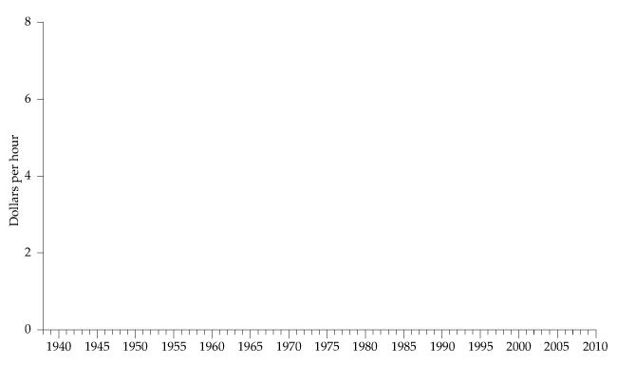


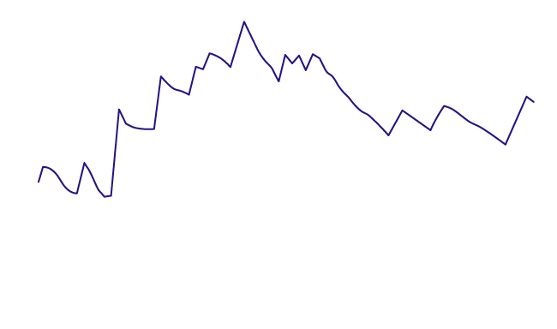

REAL VERSUS NOMINAL PRICES
1.3
Figure 1.1
The Minimum Wage
In nominal terms, the minimum wage has increased steadily over the past 70 years.
However, in real terms its expected 2010 level is below that of the 1970s.

Slide 17
WHY STUDY MICROECONOMICS?
1.4
Corporate Decision Making: Ford’s Sport Utility Vehicles
The design and efficient production of Ford’s SUVs involved not only some impressive engineering, but a lot of economics as well.
---------------------------------------------------------------------------------
First, Ford had to think carefully about how the public would react to the design and performance of its new products.
Next, Ford had to be concerned with the cost of manufacturing these cars.
Finally, Ford had to think about its relationship to the government and the effects of regulatory policies.

Slide 18
WHY STUDY MICROECONOMICS?
1.4
Public Policy Design: Automobile Emission Standards for the Twenty-First Century
The design of a program like the Clean Air Act involves a good deal of economics.
________________________________________________
First, the government must evaluate the monetary impact of the program on consumers.
The government must determine how new standards will affect the cost of producing cars.
Finally, the government must ask why the problems related to air pollution are not solved by our market-oriented economy.

